Slide 1




Playwright
Integration with Various Test Frameworks

Slide 2

Introduction
Installing
Adding TypeScript
Adding Jest
Writing simple Playwright tests
Running on all browsers
Adding globalTypes.ts
Debugging our test
Summary
Overview

Slide 3
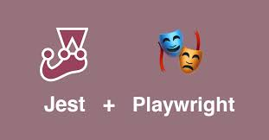

Slide 4
jest-playwright
Multi-browser and device (like iPhones with given screen sizes) support
jest-dev-server integration which can start your webserver like create-react-app before running the tests
expect-playwright integration which provides common expect helper functions

Slide 5
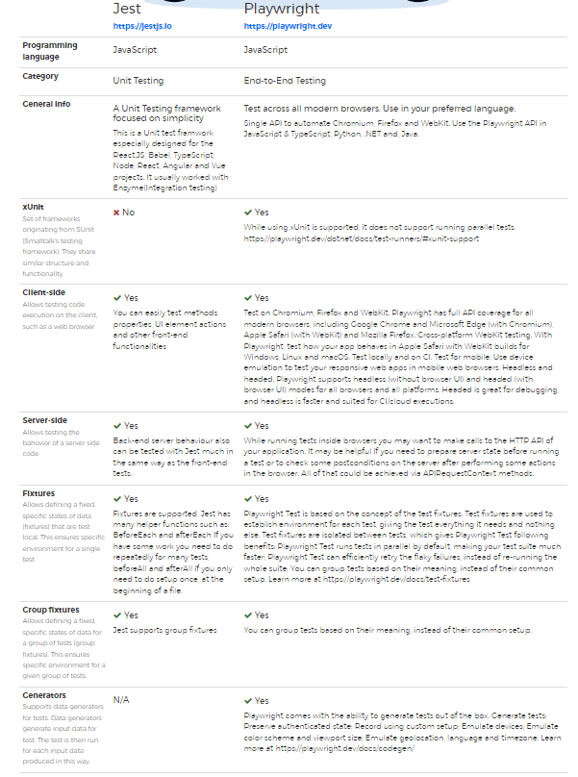
Summary

